Slide 1
Animation Movies
Author name
Institutional affiliation

Slide 2
Introduction to Animation Movies
Animation is a method of creating pictures to be in movement (Yang, 2020).
Initially, there were referred to as cartoons.
Animations are made of computer generated images (CGI).
The creation of animation is complex and requires techniques.
There are several types of animation movies.
Notes:
An animated movie or a cartoon is made up of series of drawings of people, animals, and objects that seem to be in motion. The concept of animation begun in 1833, with sequential images shown one by one in a quick succession. Through animation movies, storytellers can tell more about their stories in a different interesting way. Animation therefore involves the creation of motion in pictures, drawings, models among others (Yang, 2020). CGI has made creation of animations easier. Types of animation movies include traditional animation, stop motion, 3D animation, motion graphics, and 2D animation (Yang, 2020).

Slide 3
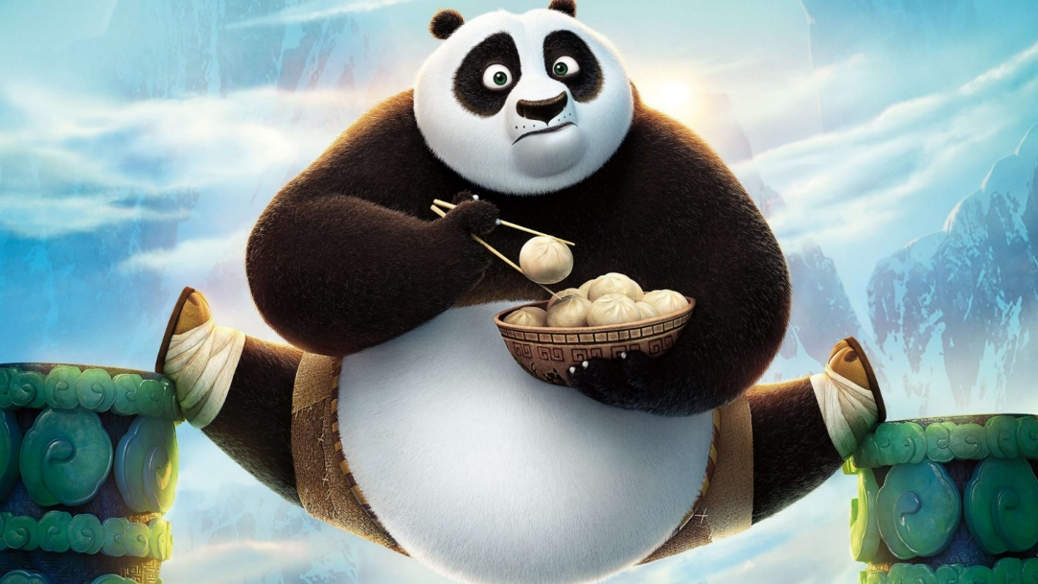
Image Showing one of the Animation Movies

Slide 4
CONT’
Children can perceive animation movies easily.
Just as the normal movies, animations uses various techniques.
This techniques involve the use of music, stop motion fade, J cuts, jump cuts, eye line match among others.
These techniques is to make the animation movies interesting.
They also draw the viewers attention.
Notes:
Animations are very important because children can perceive them easily compared to other movies. Through animation movies, people have been able to tell their stories, ideas, and communicate their emotions. Creation of animation movies shows a lot of creativity in the use of editing techniques such as stop motion , animatronics, motion capture, rotoscoping, fade, jump cuts among others.

Slide 5
Benefits of animation movies
There are many benefits associated with animation movies;
One can make animation movies in confined circumstances.
Problems involving personnel are minimized.
Less demands with animation movies.
Animation movies are cost effective (Craven, 2015).
Notes:
One of the major benefits of making animation movies is that one can work anywhere. Weather problems are minimized such as cold winter seasons, which highly disrupt outdoor shooting in ordinary movies (Craven, 2015) . Also, with animation series, one does not have to ask for permission for locations to film the movie. Dealing with movie personnel is perceived as a hard nut to crack. This is because different costumes are required, makeup, sets costs. Production of animation movies has less demands and is considered as socially connective. Animation movies minimize consumption of film stock. For instance, editing effects with a camera are significantly minimized.

Slide 6
Use of Stop Motion in Animation Movies
Stop motion technique is the way through which objects appear to be in motion (Shaw, 2012)
Objects in motion can also change.
Objects commonly used are Puppets or plasticine figures.
For successful stop motion, software's such as Dragonframe.
Notes:
The first stop motion animation film was done in 1898 by James Stuart Blackton’s Stop motion technique is a used while making animations by manipulating objects to appear as though they are in motion and appear to be huge. Through this technique, series of frames also (Shaw, 2012). Through stop motion, video production has become possible. The cost of using stop motion depends with how long the project takes and the quality of the animation movie required. Puppets and plasticine seem to appear as though they are in motion during the film making. Computer softwares are used to make animation movies. Commonly used software include dragon frame, istopmotion, stop motion pro among others.

Slide 7
Types of stop motion in animation movies
According to Andrew Selby, (2013), there are various types of stop motions;
Sand and oil-paint animation.
Armatures
Puppets
Simple paper cut-outs
Claymation (clay animation).
Model and object animation
Notes:
Sand and oil-paint animation involves using substances such as sand and oil onto a non-porous surface. The oil or sand are manipulated by the animator and photographed using a camera in the light. The second type of animation is armatures whereby they are structural frameworks acting as a base for stop motion model. Puppets stop motion on the other hand refers to any motion that uses puppets. Selby (2013), avers that simple paper cut-outs are forms of stop motion that involves using pieces of paper, tearing or folding, card, cloth, and folding into desired shapes and manipulating them between photographs for stop motion. Clay animation stop motion involves the construction of sets, characters and props using plasticine. Additional armatures are used with Claymation. Model and object animation are stop motion which is used with live action (Selby,2013).

Slide 8
Strike animation movie
Strike is an animation movie written by Neil James
It was directed by Trevor hardy.
The animation is about the story of Mungo Morrison, a young mole.
Morrison secretly wants to become a footballer but his father wants him to run a goldmine.
Through his effort, Mungo make it to the cup football finals in Russia.
Notes:
The storyline of the strike animation movie is about a young mole known as Morrison who is secretly passionate about football but his father wants him to run a legendary goldmine. His friends are excited to join him in the goldmine. Despite Morrison being a small mole, he does not give up on his dream and he decides to play football in bright light after the mine is forced to shut down following an accident in the goldmine. With the help of his friends Morrison is excited to begin with the new journal of football whereby he attends the wild cup football finals in Russia.

Slide 9
Use of stop motion in Strike
Strike is an animation movie that was realised in April 2020.
The movie was released by gigglefish.
The animation movie uses stop motion.
Puppets are used in these movie.
The movie is about a mole with a goal .
The movie is a handmade stop motion.
Notes:
Strike is an example of an animation movie that uses stop motion. In these movie, puppets resembling moles have been used by the storyteller to bring the movie into life. The animation is beautifully hand crafted. In the animation movie, the characters are well developed and diversified. The characters are also interesting and eccentric. The animation movie also took a longer time to accomplish as most animation take longer periods. The movie runs for 100 minutes.

Slide 10
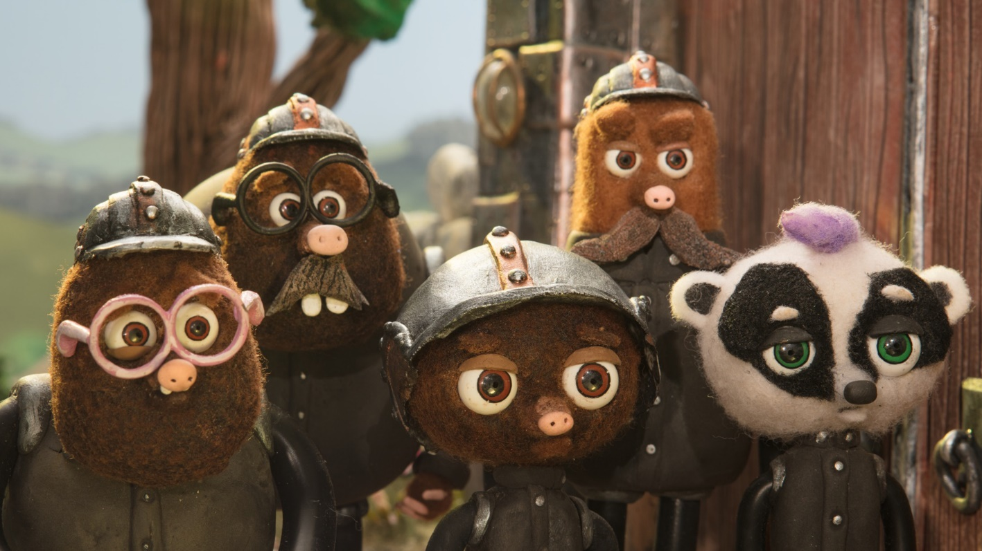
Image of the Strike Animation Movie

Slide 11
CONT’
Mole puppets photographs have been played together.
A higher speed is used to make an illusion to the viewer.
Different frames have been used in the movie.
Through the use of stop motion software helped in the success of the movie.
After completion, music and sound effects were then added up.
The movie has a good setting with good lighting.
Notes:
Frames are defined as series of different pictures taken that are used in making the animation movies so that the puppets appear to be in motion. After creation of the movements in the strike movie, music and sound effects were then added making a complete movie. This becomes possible by the use editing softwares.

Slide 12
References
Craven, I. (2015). Eine Annäherung an den Avantgardismus? Amateur-animation und das Ringen mit der Technik.
Selby, A. 2013. Animation. London: Laurence King.
Shaw, S. (2012). Stop motion: Craft skills for model animation. Taylor & Francis.
Yang, L. (2020). On the Creation of Animation Films Based on Virtual Reality Technology. 180–183.

